Slide 1
Capstone Coursera Project
Felipe Bahamonde

Slide 2
business Problem
Our client, an important wood crafts shop located in Santiago, specifically in Peñalolen, wants to open a new store given the success. For this, he is evaluating different possibilities within Santiago but still doesn’t know where to position himself. Currently Peumayen's store is in Peñalolen because it is a sector where people have a high purchasing power, which favors the sales of Peumayen since the products are extremely expensive and not of first necessity.
It is in this context that Peumayen asks for help to locate his store, requesting that sectors or districts could be good for his new store.

Slide 3
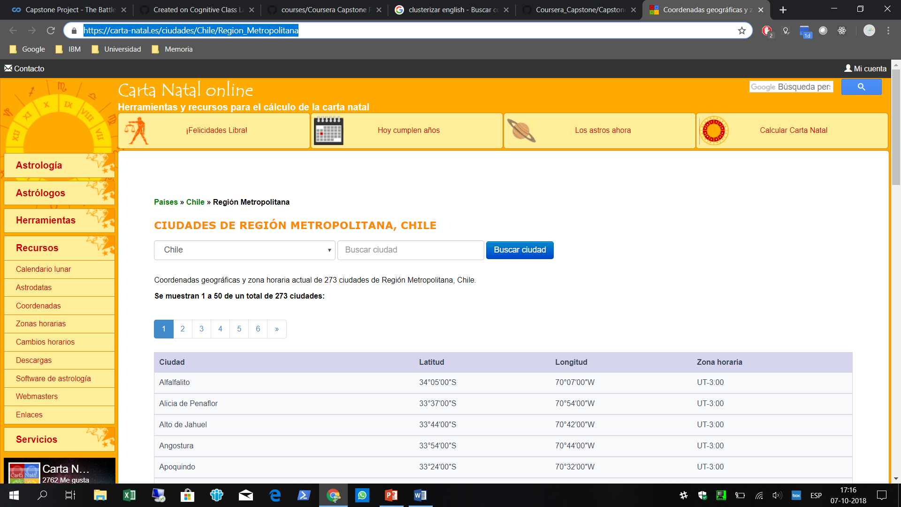
Data

Slide 4
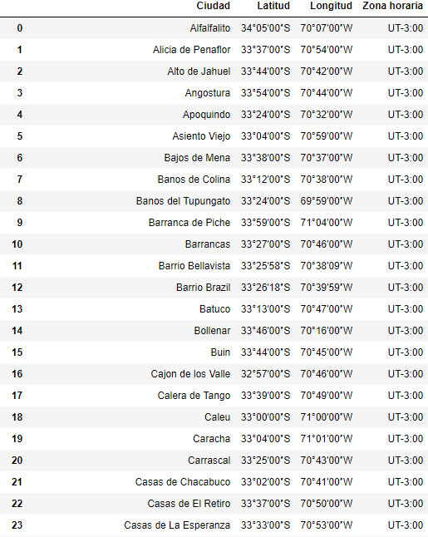
In the figure it is possible to observe the dataframe created from the web page, where we can see 273 and peak locations with their coordinates in a scale that does not allow us to use Foursquare, so it is decided to change by a small transformation. As shown in figure 2 and 3.

Slide 5
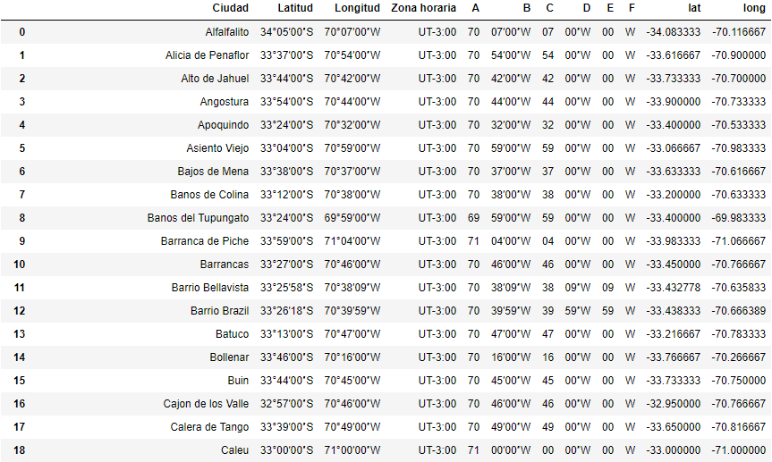
DMS -> Degrees

Slide 6
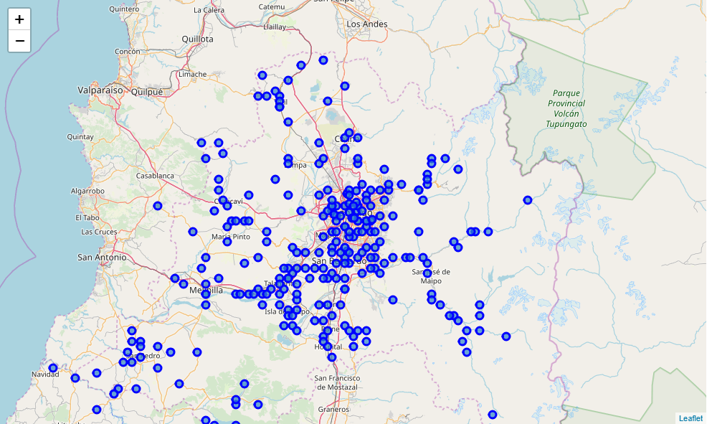
Once the change is made, a map with all the extracted localities is generated, as shown in Fig.

Slide 7
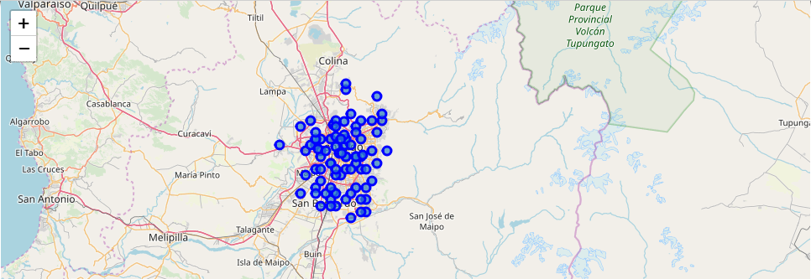
It is possible to see that many points are outside of Santiago since this involves information from the entire metropolitan region. To improve this, we decided to calculate the distance (Euclidean) to the center of Santiago (obtained with Nominatim) leaving those with a distance better than 0.3. as shown in figure (86 places)

Slide 8
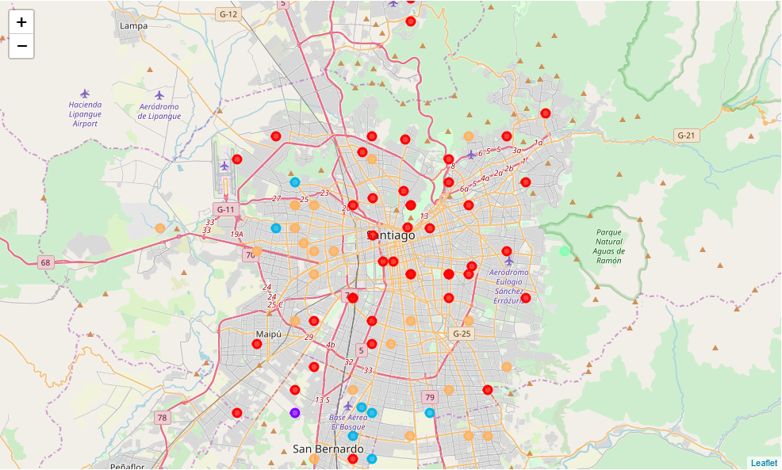


Now, we proceed to clustering to obtain the Peñalolen-like sectors as shown in fig

Slide 9
Conclusion
From this exercise it was possible to obtain results that agree with the reality of santiago where the northeastern sector has a greater purchasing power, which is what Peumayen was looking for in this fictitious case. On the other hand, you have that the foursquare’s API is not very used here in Chile, so it is suggested for future activities at the same time in this area, replaced by Google API.

